Slide 1
Flood Monitoring System
Submitted by:
Saravanan .S
Sanmugasundharam. L
Balaji.M
Sanjay.S

Slide 2
Abstract:
The climate is changing as a direct result of global warming, which is causing a range of extreme weather events to take place, including floods and intense downpours. The floods are an unexpected increase of water levels is an issue in many places of the world, and it has been known to cause damage to infrastructure as well as human fatalities. The economic effect of this flood event is accentuated for developing nations and countries with a weaker level of economic development. Based on the most recent reports from different parts of the world, terrible floods have resulted in the loss of many lives and have had an impact on a diverse spectrum of people. The last several years have seen significant advancements in technological and computer-based methods to evaluation and collaboration, both of which have contributed to improved detection performance. As a consequence of this, there is an immediate need for a means of recognizing floods. As a result, the Internet of Things devices that have the potential to detect flooding are included into the work that is planned. In order to speed up the process and guarantee precise flood detection, the Decision Making model is combined with the ESP 32 micro-controller.

Slide 3
Introduction:
Academics are paying a lot of attention to wireless sensor networks as one of the numerous approaches that are being used to keep a watch on floods. This is one of the many methods that are being employed. The ground water, humidity, and radiation are just few of the numerous elements that may be monitored on real - time basis. These large amounts of data may be used to make projections that have the potential to save lives by, for example, reducing the likelihood of a flood taking place. As a result, it is crucial to simplify this process in addition to decreasing the stress on people and getting rid of any costs that are not absolutely required. Flood disasters have caused incalculable damage to the nation's economy, way of life, and houses as a result of their widespread distribution, frequent occurrence, and numerous, topographical, and possibly fatal qualities. These factors have contributed to the disasters' broad spread. India's tropical climate, lengthy wet seasons, and relative isolation all contribute to the country's high risk of floods, both on their own and as a result of the ecosystem. This risk can be broken down into two categories: floods that are caused by the climate and floods that are caused by the ecosystem. It is impossible to exaggerate how important it is to have a grasp of the floods that are created by rain. Monitoring floods is one of the most difficult, complicated, and essential challenges in engineering. Its primary purpose is to cut down on the number of human and economic death.

Slide 4
Step 1: Sensor Data Collection: The process starts by calibrating and attaching the order on a board to the water level sensor. However, the board has been connected to the laptop for this purpose, and the API is built into the microcontroller board. The ESP32 board connects to the sensor to provide power and accumulate input values. The sensor has an input for power and an output for data that is transferred to the board. The board is connected by putting a Python programme onto it with the intention of gathering sensor data. The board receives a Python code, which is subsequently uploaded, and the board immediately begins to gather sensor data. These values are recognized as input and effectively stored in a list that the Python code may access.
Step 2: Preprocessing: Once the sensor input values have been processed and propagated as a list, these are provided as an input to the Python code. These variables effectively interface and look for a water level threshold value. The junk values have been eliminated from the prepossessed data, the strings are reduced, and the outcomes are utilized by the subsequent step in the method to identify a flood level event.
Step 3: Decision Making: The sensor has been set up so that it can be put on a river's flood plain or another particular region where the flood level is being tracked. The sensor's results alter or rise above a preset cutoff value if the water reaches a particular level. Once this limit is crossed, it is clear that the water level is growing uncontrollably above the desired level, and the circumstance can be classified as a flood level scenario. The if-then rules of this decision-making module are employed to determine the scenario. A voice alarm is sounded for purposes of evacuation and other disaster management measures as soon as a flood level scenario is achieved and detected by the decision-making approach. An alert is also immediately generated for the adjacent station to avoid life and death.

Slide 5
Program:
import time
import machine
import dht
# Define GPIO pins
TRIG_PIN = machine.Pin(2, machine.Pin.OUT)
ECHO_PIN = machine.Pin(3, machine.Pin.IN)
BUZZER_PIN = machine.Pin(4, machine.Pin.OUT)
DHT_PIN = machine.Pin(5)
LED_PIN = machine.Pin(6, machine.Pin.OUT)
def distance_measurement():
# Trigger ultrasonic sensor
TRIG_PIN.on()
time.sleep_us(10)
TRIG_PIN.off()
# Wait for echo to be HIGH (start time)
while not ECHO_PIN.value():
pass
pulse_start = time.ticks_us()
# Wait for echo to be LOW (end time)
while ECHO_PIN.value():
pass
pulse_end = time.ticks_us()
# Calculate distance
pulse_duration = time.ticks_diff(pulse_end, pulse_start)
distance = pulse_duration / 58 # Speed of sound (343 m/s) divided by 2
return distance

Slide 6
def read_dht_sensor():
d = dht.DHT22(DHT_PIN)
d.measure()
return d.temperature(), d.humidity()
buzz_start_time = None # To track when the buzzer started
while True:
dist = distance_measurement()
temp, humidity = read_dht_sensor()
# Check if the distance is less than a threshold (e.g., 50 cm)
if dist < 50:
# Turn on the buzzer and LED
BUZZER_PIN.on()
LED_PIN.on()
status = "Flooding Detected"
buzz_start_time = time.ticks_ms()
elif buzz_start_time is not None and time.ticks_diff(time.ticks_ms(), buzz_start_time) >= 60000: # 1 minute
# Turn off the buzzer and LED after 1 minute
BUZZER_PIN.off()
LED_PIN.off()
status = "No Flooding Detected"
else:
status = "No Flooding Detected"
print(f"Distance: {dist:.2f} cm")
print(f"Temperature: {temp:.2f}°C, Humidity: {humidity:.2f}%")
print("Status:", status)
time.sleep(2)

Slide 7
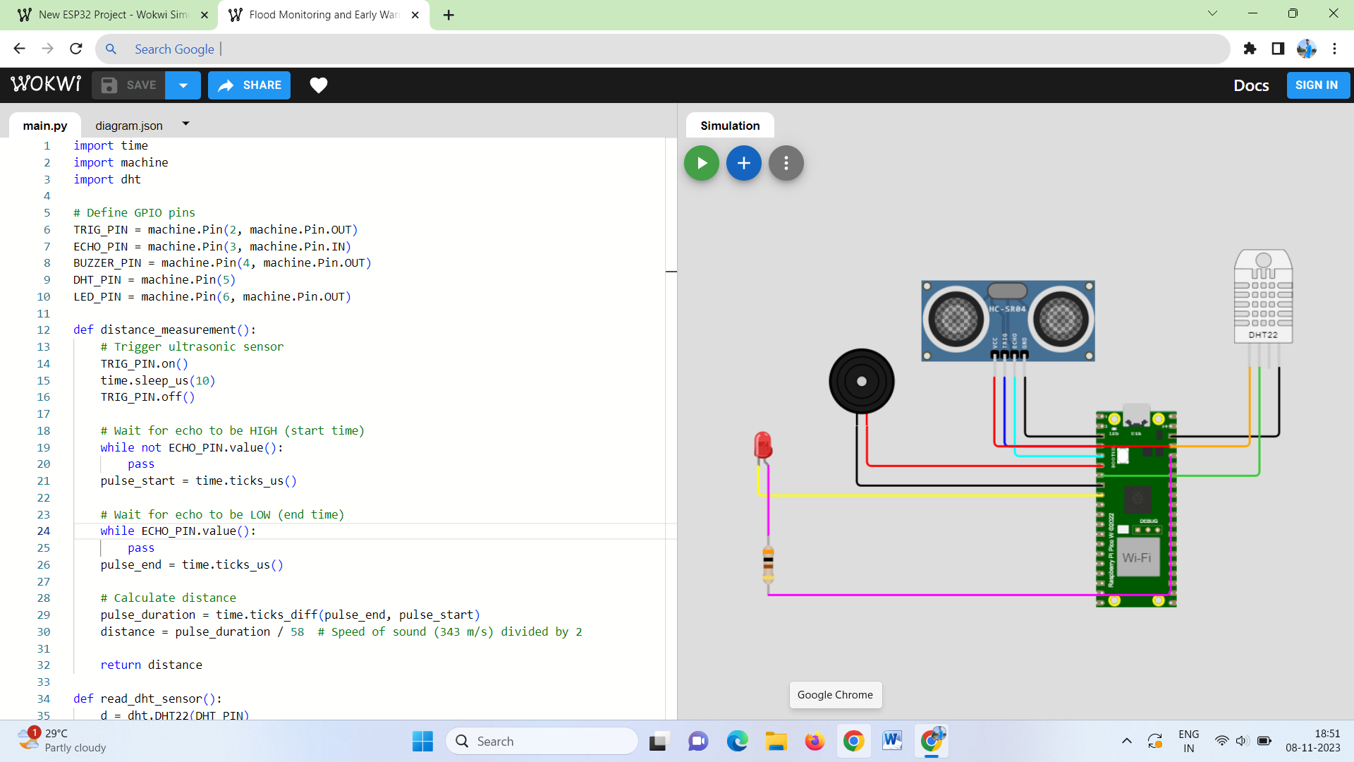

Slide 8
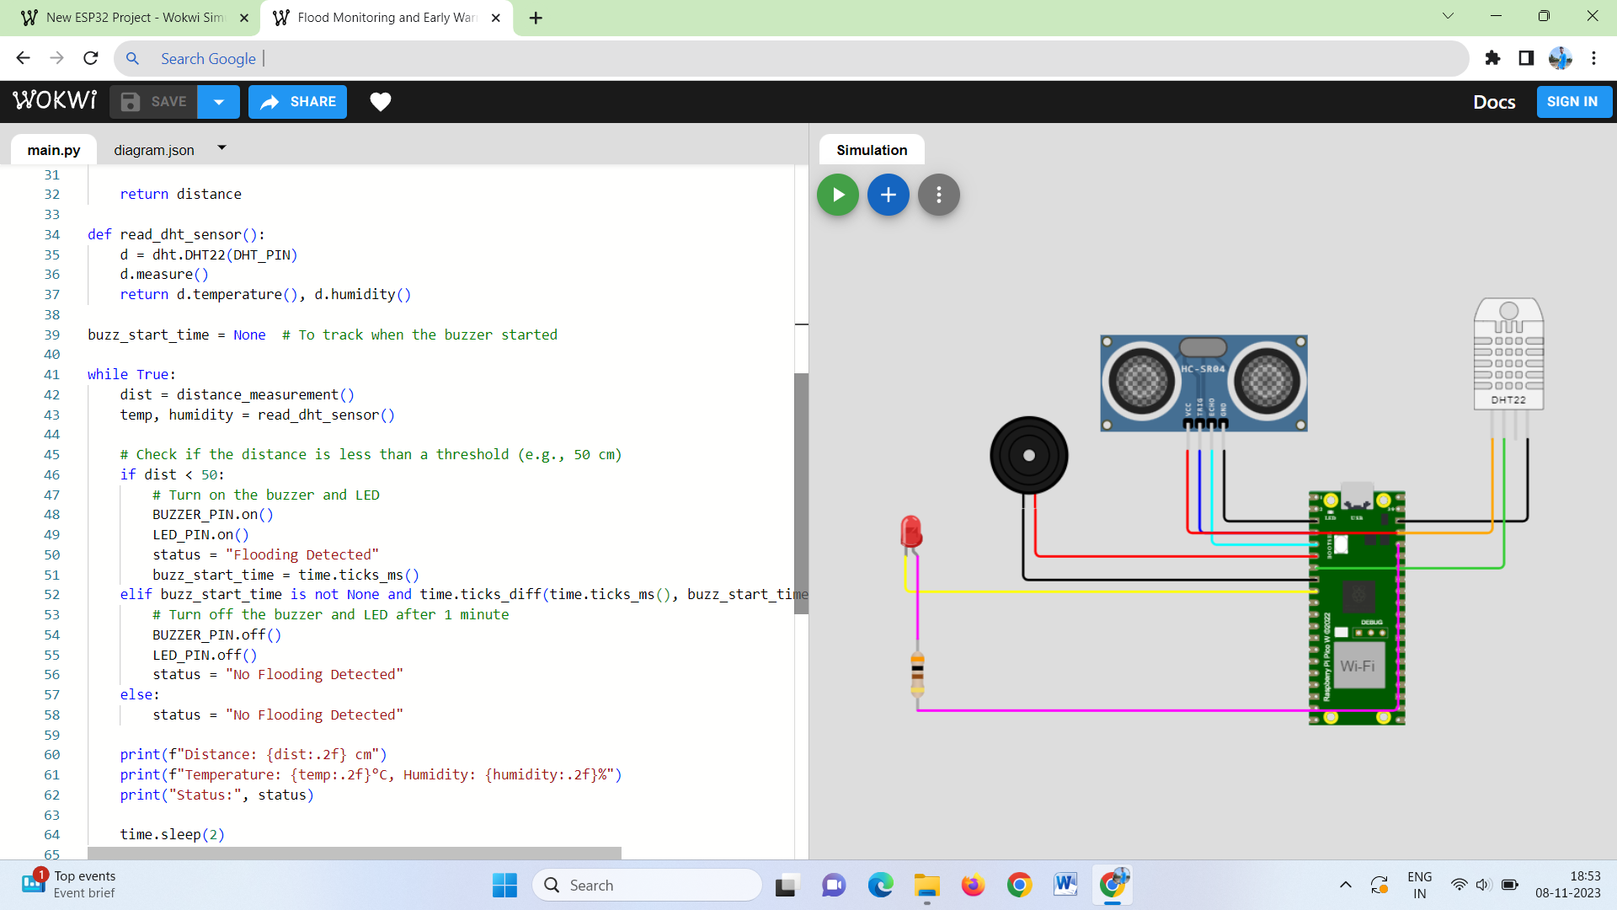

Slide 9
Conclusion:
The mini-python IDE and some libraries written in the Python programming language were used to build the proposed framework for an efficient flood warning system. This made it feasible for the automatically generated flood warning to be successful in saving lives in a real-time scenario. The technique suggested was implemented on a developer laptop running Windows loaded with an Intel Core i5 CPU and 8 GB of RAM. To measure the dependability of the provided solution, the errors encountered when deploying and executing it must be assessed

Slide 10


